Slide 1


Deploying a Web Application on Amazon ECS
Prepared in the partial fullfillment of the Summer Internship Program on AWS
AT
Under the guidance of
Mrs. Sumana Bethala, APSSDC
Mr.Anil Kumar, APSSDC
Notes:
Under the guidance of Mrs. Sumana Bethala, APSSDC Mr.Anil Kumar, APSSD

Slide 2
PROJECT MEMBERS:
➢REGIDI MADHAVI
➢RONGALA CHINNARI
➢GUBBALA CHAITANYA SRUTHI
➢VARADA SAMEAL RAJU

Slide 3
Deploying a Web Application on Amazon ECS
Amazon EC2 (Elastic Compute Cloud)
Amazon ECR (Elastic Container Registry)
Amazon ECS (Elastic Container Service)
AWS Fargate (within ECS)
Elastic Load Balancing (Application Load Balancer - ALB)
Amazon VPC (Virtual Private Cloud)
AWS IAM (Identity and Access Management)

Slide 4
Problem Statement
Modern web applications require reliable, scalable, and highly available infrastructure.
Manual provisioning and deployment are error-prone and time-consuming.
Challenges:
- Managing compute resources dynamically
- Containerizing applications
- Scaling with demand
- Simplifying deployment workflows
Goal:
Deploy a containerized web application using AWS services like ECS, EC2, ECR, Fargate, and ALB.

Slide 5
Solution Overview
Implemented a fully containerized web application hosted on Amazon ECS.
Architecture Highlights:
Docker to containerize the app
Amazon ECR to store the image
Amazon ECS for orchestration
EC2 & Fargate to run containers
Application Load Balancer for routing
IAM Roles, VPC, Security Groups for secure access

Slide 6
Key Features
1. Containerization: Portable and reproducible builds using Docker
2. Scalability: ECS with Fargate scales based on CPU/memory
3. High Availability: Load balancer distributes traffic
4. Security: IAM, VPC, and security group controls
5. CI/CD Friendly: Easily pluggable with CodePipeline/CodeBuild
6. Cost-Effective: Pay for compute only when used (Fargate)

Slide 7
Tools & Technologies
AWS ECS (EC2 + Fargate)
Docker
Amazon ECR
Application Load Balancer
IAM, Security Groups, VPC
EC2 Instances

Slide 8
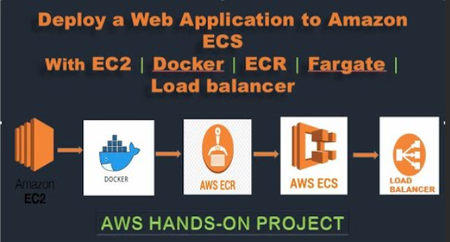
Architecture Diagram

Slide 9
1. Amazon EC2 (Elastic Compute Cloud)
Purpose: Acts as a development/CI environment where you create and build your Docker image.
What Happens Here:
Launch an EC2 instance (Linux/Ubuntu).
Install Docker on EC2.
Write your application code and a Dockerfile.
Build the Docker image locally on EC2.
2. Docker
Purpose: Containerizes your web application for easy deployment.
What Happens Here:
Use Docker to build an image from the application code.
Tag the Docker image for upload to ECR.
3. AWS ECR (Elastic Container Registry)
Purpose: A fully managed Docker container registry.
What Happens Here:
Push the Docker image from EC2 to ECR.
ECR stores and version controls your image for ECS deployments.

Slide 10
4. AWS ECS (Elastic Container Service)
Purpose: Orchestrates the deployment of containerized applications.
What Happens Here:
Create a Task Definition using the image from ECR.
Choose Fargate as the launch type (serverless deployment).
ECS runs your container with the required CPU, memory, and networking settings.
5. Fargate (Launch Type)
Purpose: Serverless compute engine for containers.
What Happens Here:
You don’t manage servers — Fargate provisions infrastructure automatically.
ECS service ensures your application stays running and scalable.
6. Load Balancer (Elastic Load Balancer - ELB)
Purpose: Distributes incoming traffic to ECS tasks.
What Happens Here:
Set up an Application Load Balancer (ALB).
ALB routes traffic to your running containers behind the scenes.
Ensures high availability and fault tolerance.

Slide 11
Learnings and Outcomes
Understood ECS launch types: EC2 vs Fargate
Hands-on with Docker, ECR, and ALB configuration
Importance of IAM roles and networking setup
Troubleshooting deployment issues
Learned how to automate multi-step cloud deployments

Slide 12
Conclusion & Next Steps
Conclusion:
Successfully deployed a production-grade web application on AWS ECS with full container orchestration and traffic management.
Next Steps:
Automate using CodePipeline
Implement HTTPS with ACM
Explore service discovery and auto-scaling

